Slide 1

DIGIT
WEBINAR
RPaM PoC
Proof of Concept for Representation Powers and Mandates Ontology
Webinar
January 16th 2020

Slide 2


Round Table
DIGIT and MS
everis team
European Commission
Miguel Álvarez-Rodríguez (DIGIT, project owner)
Jeroen Rathe (DIGIT, project owner)
Carlos Gómez-Muñoz (DG CNNECT, project owner)
Valentin Mesaros (DIGIT, analyst)
Member States and Stakeholders in previous meetings:
MSs: AT, BE, CZ, ES, FI, GR, HU, LU, NL, SI, SK, other?
Stakeholders: SEMPER, TOOP, other?
Everis RPaM Team
Sancho Sancho Canela (Project manager)
Rui Venâncio (Client manager)
Enric Staromiejski
(eGovernment and interoperability expert)
Maria Font Sanchez (Developer)
Konstantin Petrov Ivanov (Developer)
Jade Maana (Business Analyst)
Michael Weaver Pushee (Technical Writer)
Point of Contact: rpam@everis.com

Slide 3
Agenda
Round Table
Context and Objectives
Implications on the Ontology Model
Live demo
Results and Conclusions for the future
Questions and Feedback

Slide 4
Context and Objectives
01

Slide 5
1
Context and Objectives
A European Common format for Representation Powers and Mandates
Phase 3
Phase 2
RPaM XSD Model
Local Proof of Concept
RPaM Validation Service
Working Group Meetings
EU Powers Taxonomy
RPaM Ontology
Phase 1
Desk Research
Business Analysis
Definition of use cases and scenarios.
Solutions Architecture

Slide 6

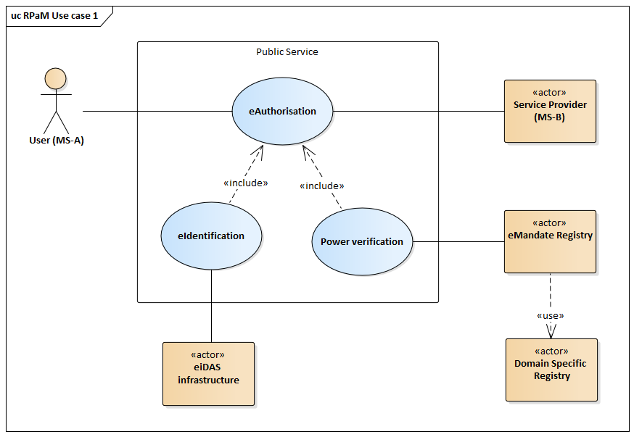



1
Context and Objectives
PoC Participants
The objective of the RPaM Proof of Concept is to verify the feasability of the RPaM Use Case 1 – Cross border e-Authorisation.
Austria
Finland
The Netherlands
DG TAXUD
https://www.itb.ec.europa.eu/rpam/upload
The data provided by the member states has been used to:
Improve RPaM Ontology.
Improve the design of the RPaM Solutions.
Create RPaM Artefacts.
RPaM Solutions
RPaM Simulation Pipeline: Local Implementation of a system allowing the delegation of powers across borders.
RPaM Validation Service: Validation platform powered by the ISA Interoperability testbed for the validation of eMandate Requests and eMandate Responses.

Slide 7
02
Implications on the Ontology Model

Slide 8
2
Implications on the Ontology Model
The Proof Of Concept lead to the upgrade of the RPaM Model.
The actions of this upgrade consisted of:
Updating of the EU Powers Taxonomy,
Updating the Conceptual Model, the following diagrams have evolved:
Mandate
eMandate Request
eMandate Response
Participation in the evolution of the Core Criterion and Evidence Vocabulary (Currently in development by SEMIC).
Updating of OWL-DL-Turtle syntax-binding.
Creatiing of RPaM XML Schema.

Slide 9
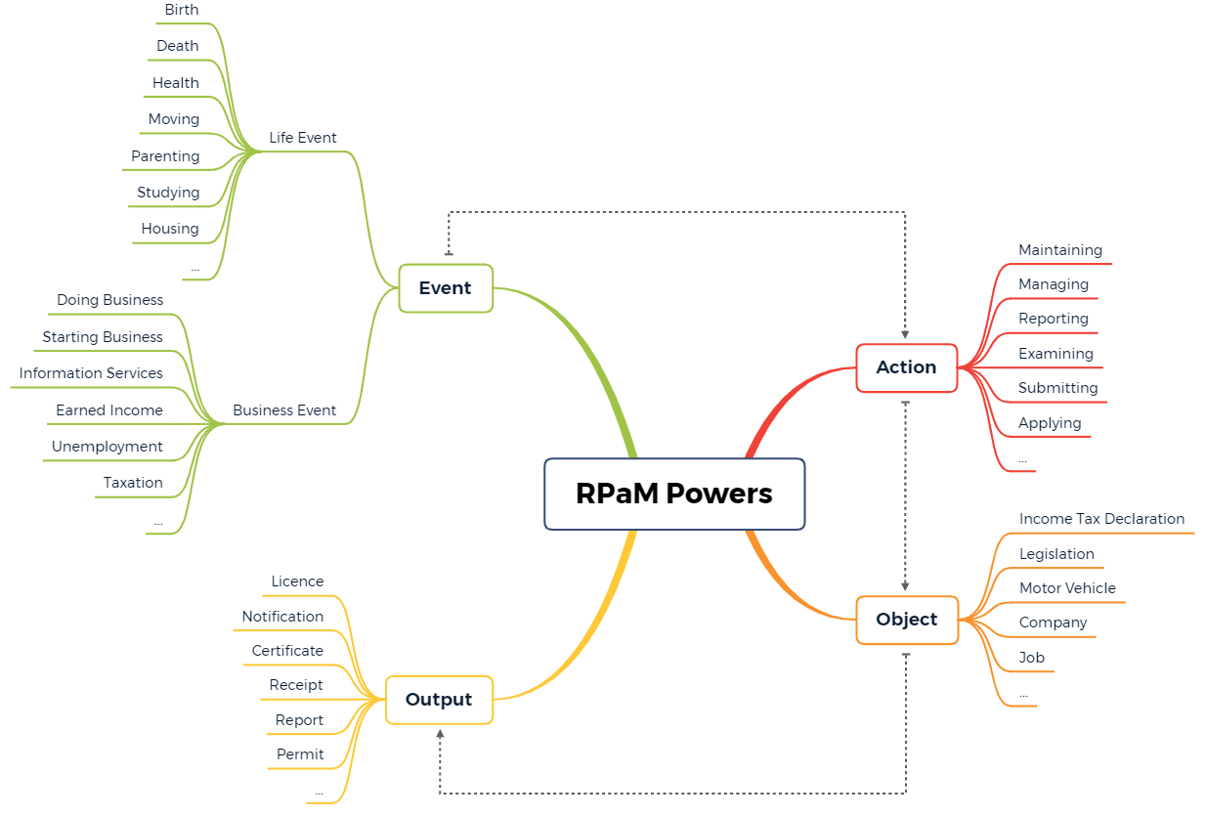
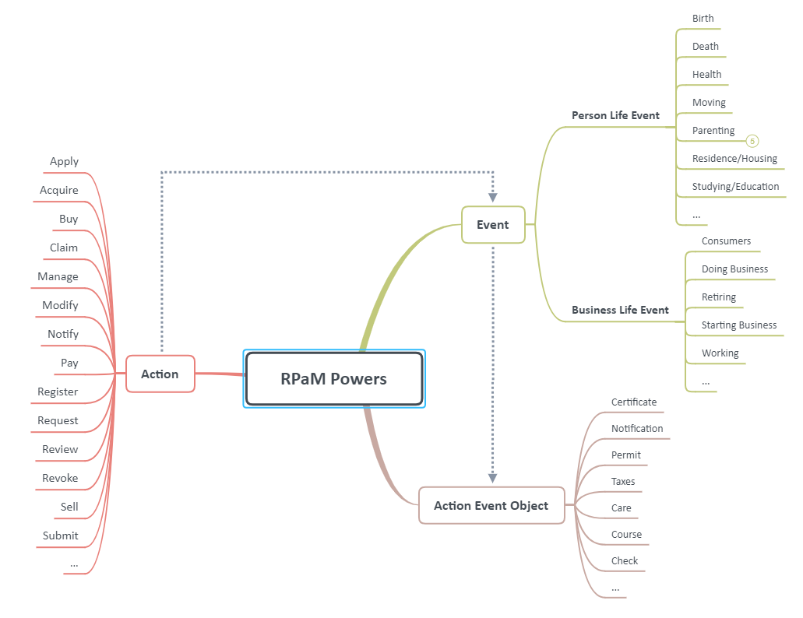
EU Powers
Taxonomy
2.1
PREVIOUS
CURRENT

Slide 10
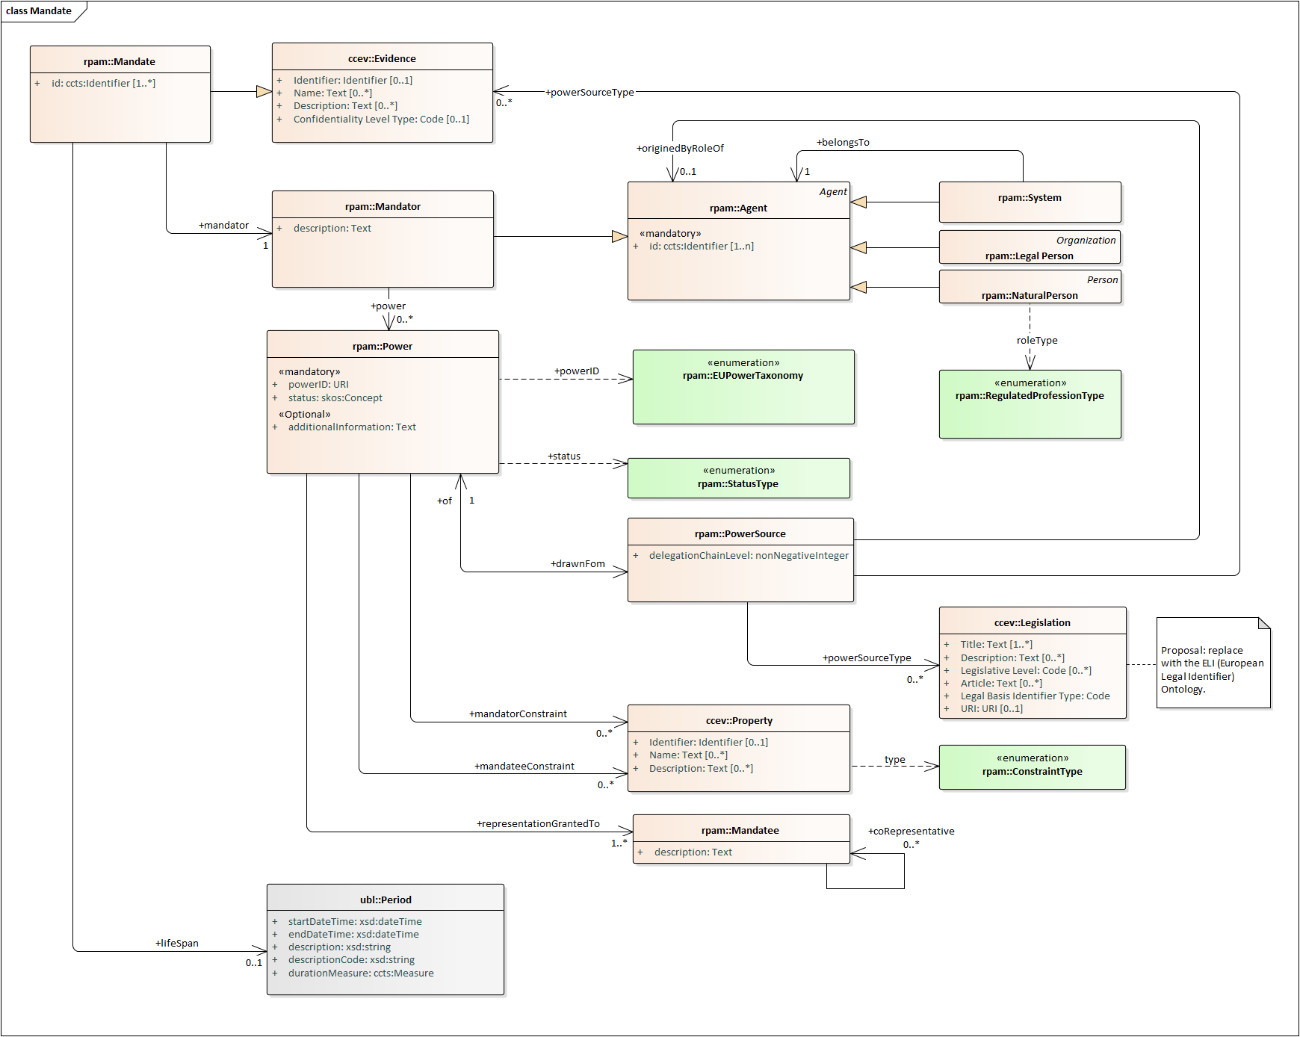
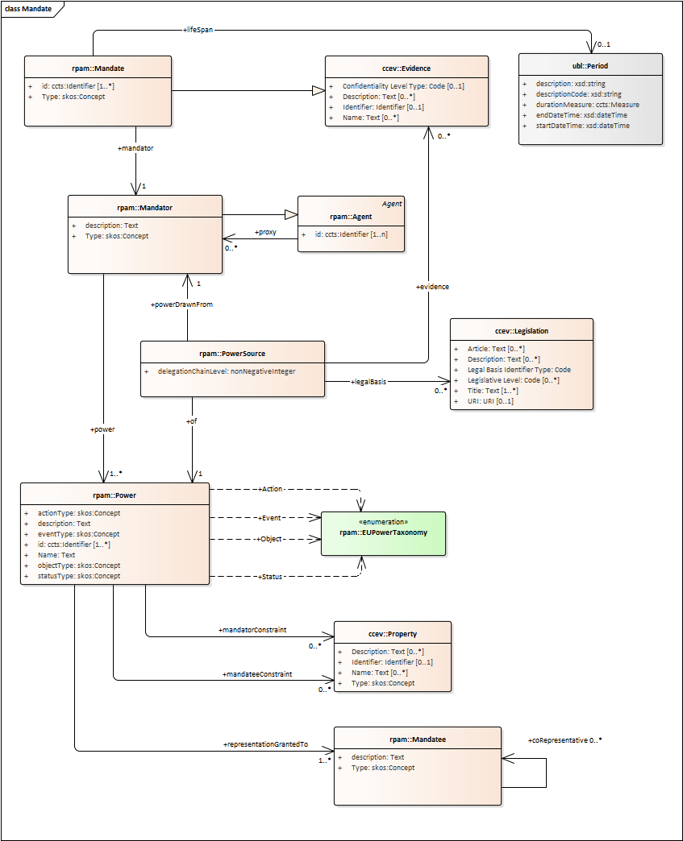
2.2
Model stabilisation – Mandate
Phased out:
Type: skos
Agent: Proxy
Power Type
Event Type
Object Type
Added:
Power Source Type
Power ID
Originated By Role
Belongs to New version of CCEV

Slide 11
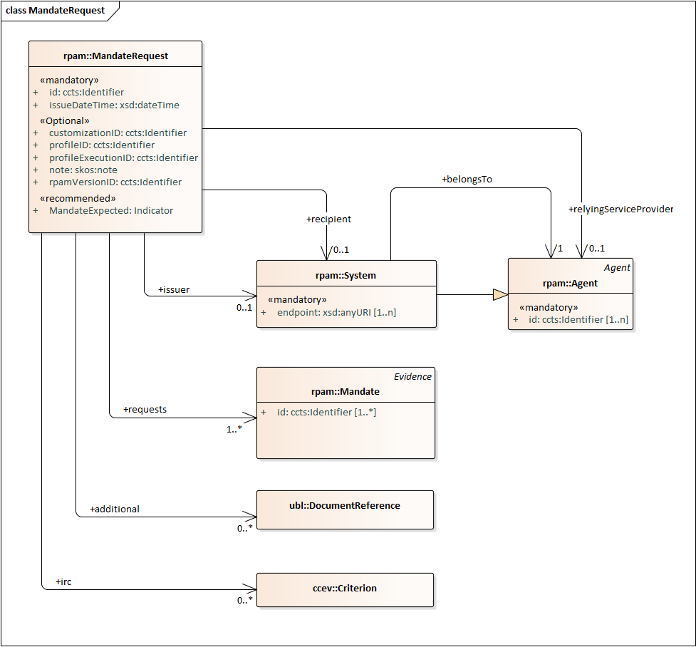

2.3
Model stabilisation – Mandate Request
Added:
“Mandate Expected” to allow a service provider to specify if the information in the mandate is expected in the response.
Issuer.
Recipient.
Relying Service Provider.

Slide 12
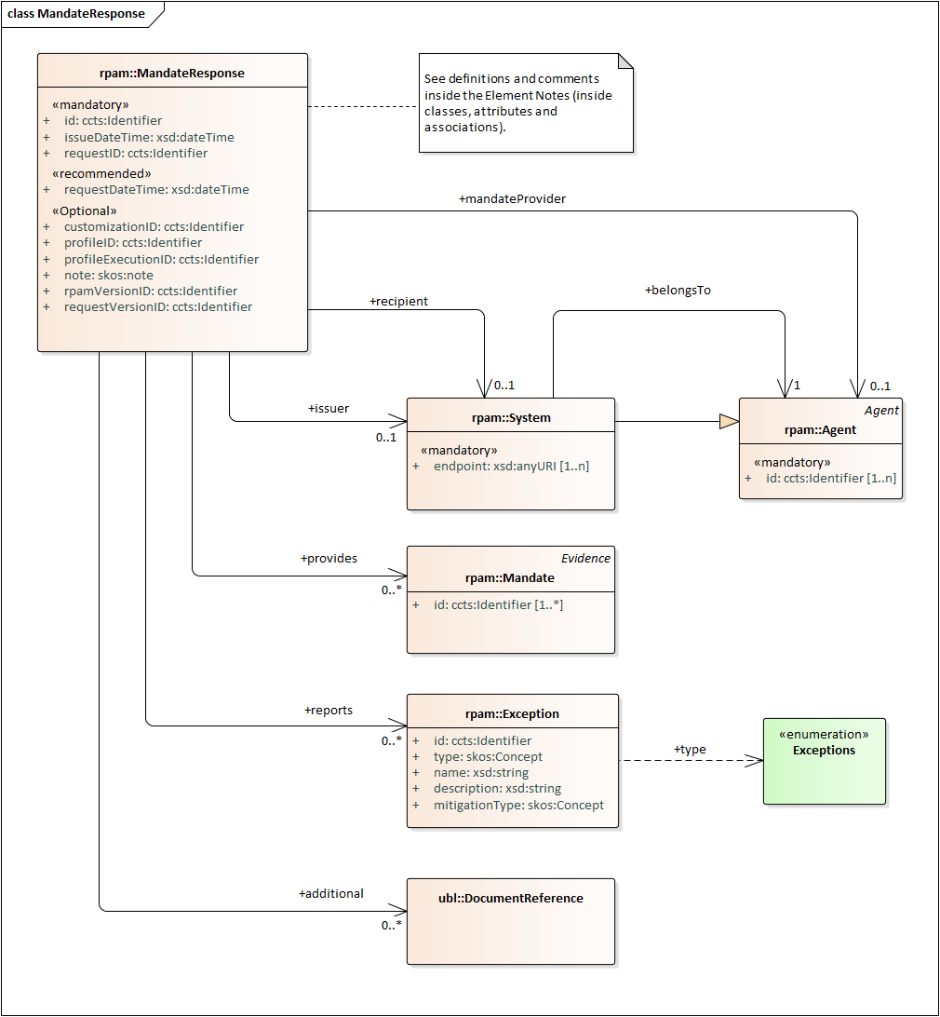
2.4
Model stabilisation – Mandate Response
Added:
“Mandate Expected” to allow a service provider to specify if the information in the mandate is expected in the response.
Issuer.
Recipient.
Mandate Provider.

Slide 13
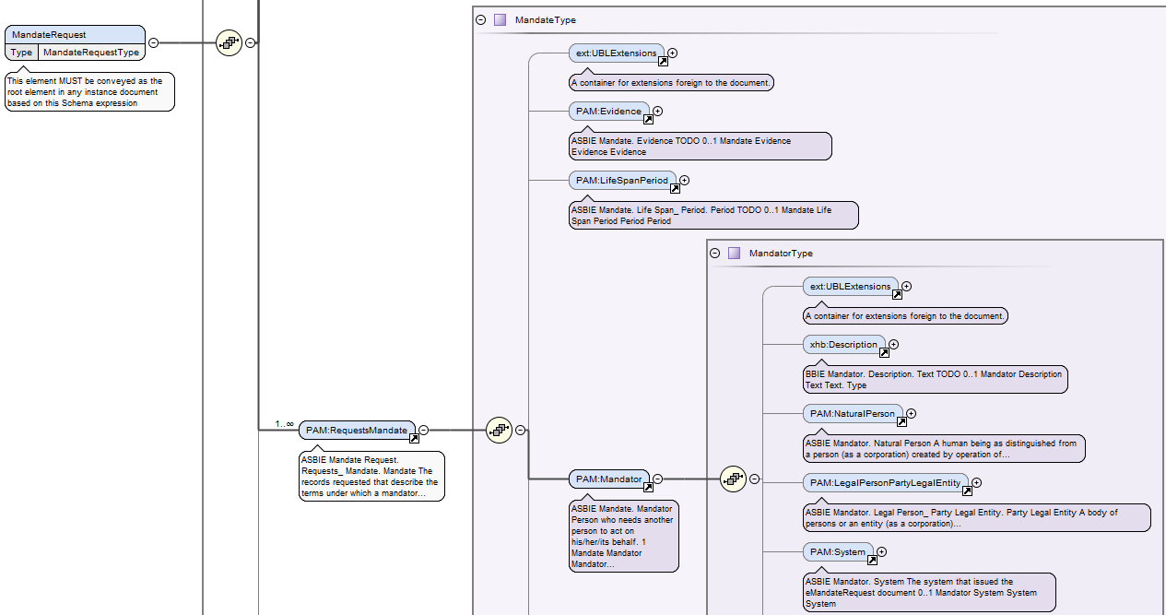
2.5
RPaM XSD

Slide 14
03
Live Demo

Slide 15
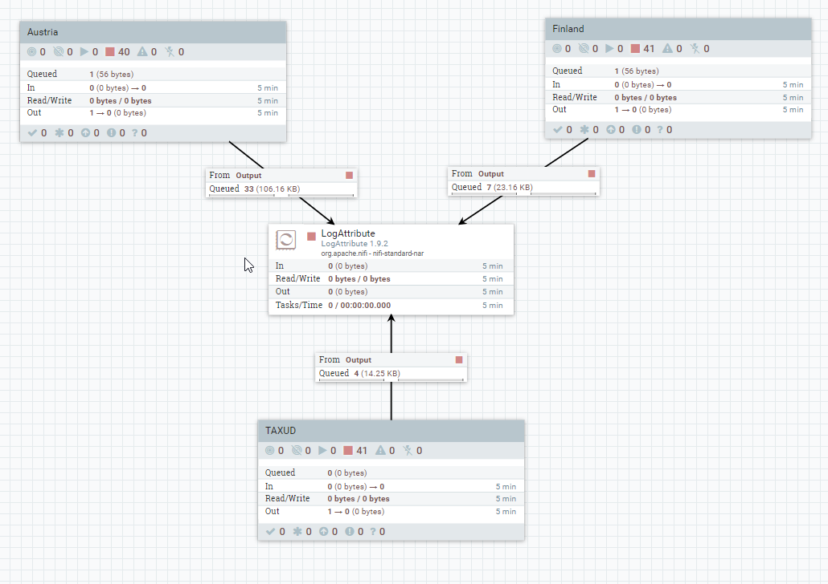

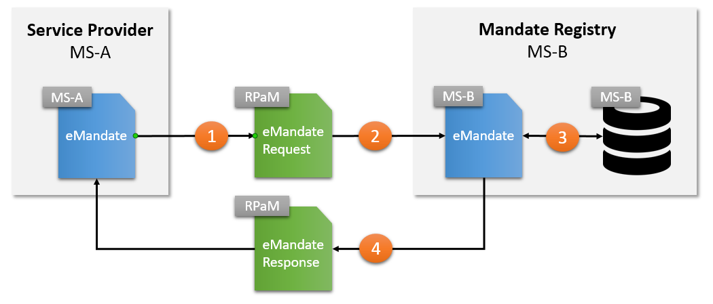
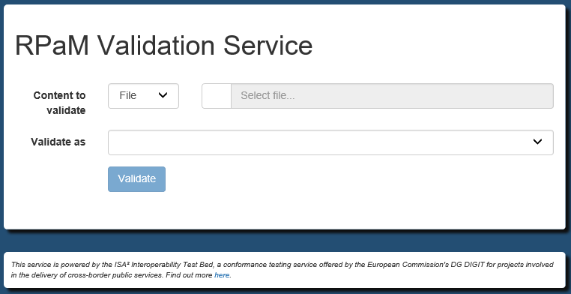
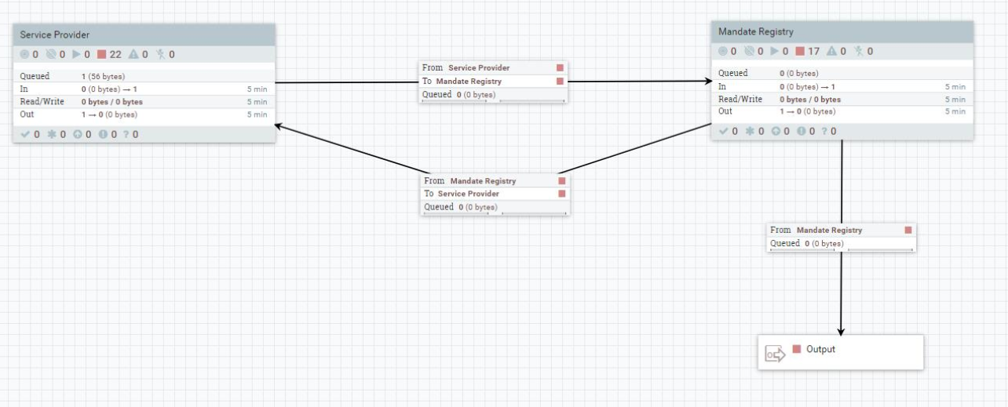


3
Live Demo
RPAM PoC Solutions
1 – RPaM Local Simulation – Use case 1
2 - RPaM Validation Service
1
2
RPaM Ontology

Slide 16
04
Results and Considerations for the future

Slide 17
4
Results and Considerations for the future
Results
Artefacts:
RPaM XML Model – XSD.
Transformation Artefacts – XSLT.
Validation Artefact – ISO Schematron.
Solutions:
RPaM Simulation pipeline.
RPaM Validation Service deployed in the Interoperability Testbed.
Documentation:
Definition of the RPaM Proof of Concept.
RPaM User Manual.
https://github.com/everis-rpam/RPaM-Ontology/wiki

Slide 18
4
Results and Considerations for the future
Conclusions
The Proof of Concept confirms that the RPaM Ontology allows cross-border mandatee e-Authorisation.
In order to guarantee the exchange of information on mandates across borders, every EU Member State must adopt a common taxonomy of powers or a subset of this taxonomy.
The prerequisite for advancing in the RPaM project is the legal support – via binding legislations – of a common taxonomy of powers and/or a common catalogue of services.
Next Steps
Implementation of RPaM Solutions on the premises of the Member States.
Proof Of Concept for other RPaM Use Cases (e.g. Cross-border mandates creation).
Work with ongoing initiatives where the RPaM Ontology can be reused.
Feedback: rpam@everis.com

Slide 19
Questions and Feedback

